Slide 1
People Committee's Binh Chanh District
Vo Van Van Secondary School
Unit 10
Cities around the world
Lesson 2 cont

Slide 2
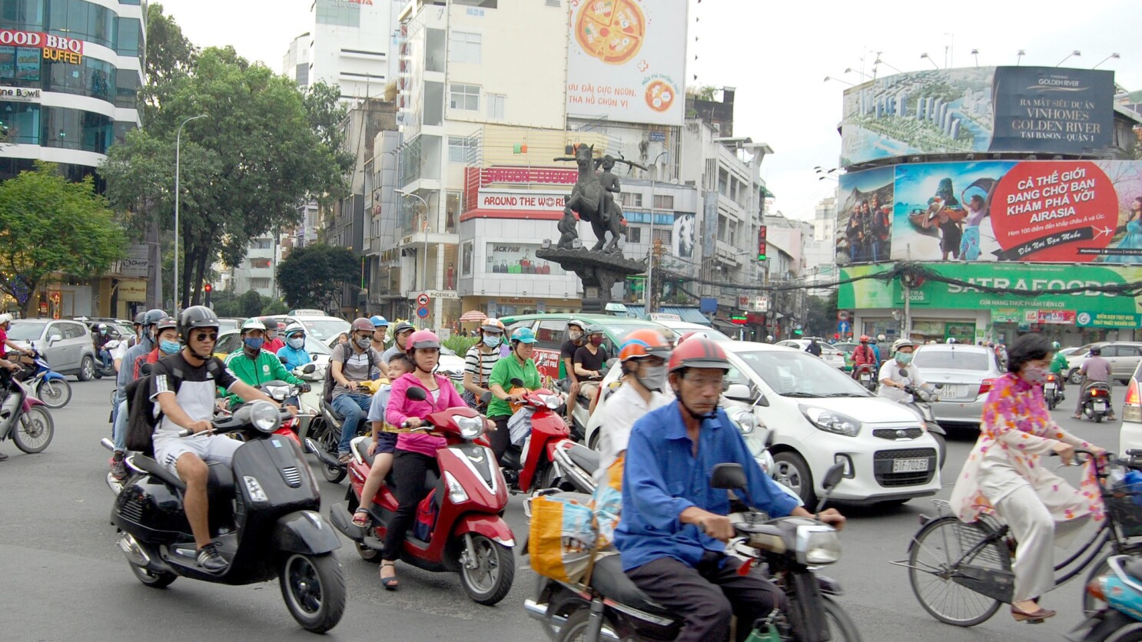
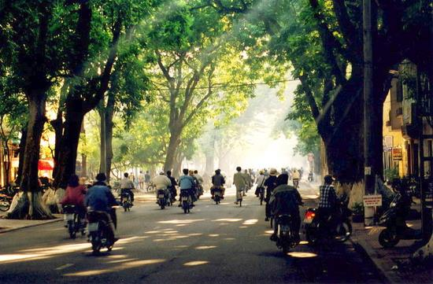
Ho Chi Minh City is noisier than Hanoi.

Slide 3
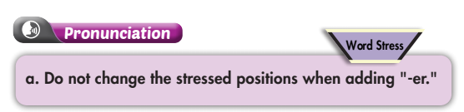



Lesson 2

Slide 4

friendly – friendlier
lazy – lazier
early - earlier

Slide 5
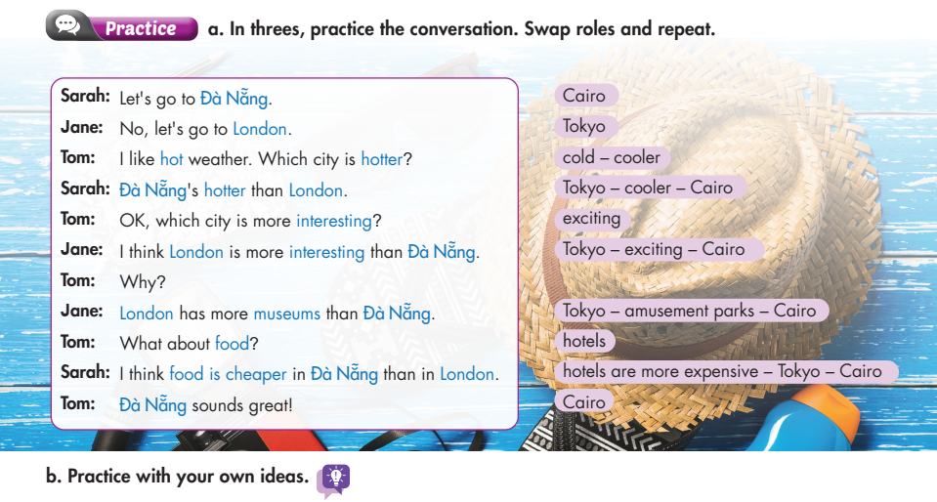
Lesson 2

Slide 6
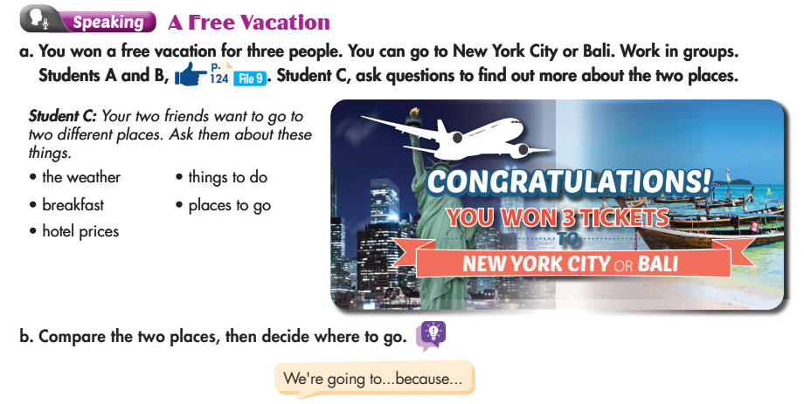
Lesson 2

Slide 7
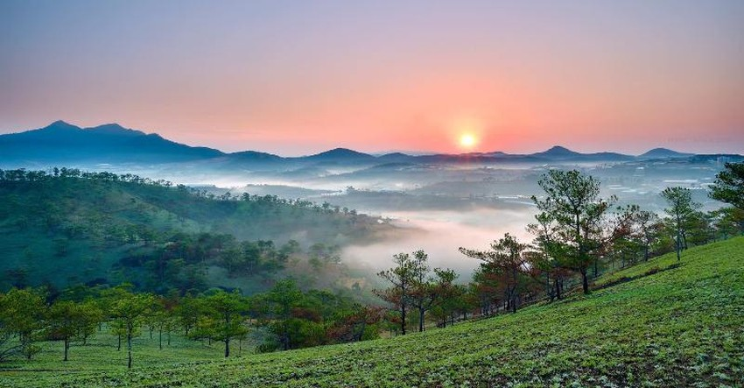

Đà Lạt City
Đà Nẵng City

Slide 8
A: Where do you want to spend your vacation this summer:
Đà Lạt or Đà Nẵng?
B: I prefer to go to Đà Nẵng.
A: Why?
B:Because ……………………………………..

Slide 9

HOMEWORK
Find some adjectives
Learn by heart

Slide 10
Irregular comparatives and superlatives
These very common adjectives have completely irregular comparative and superlative forms.
Adjective | Comparative | Superlative
good | better | best
bad | worse | worst
little | less | least
much | more | most
far | further / farther | furthest / farthest

